Slide 1
Malignant Comments Classifier Project
Project report and steps

Slide 2
Problem Statement:
The proliferation of social media enables people to express their opinions widely online. However, at the same time, this has resulted in the emergence of conflict and hate, making online environments uninviting for users. Although researchers have found that hate is a problem across multiple platforms, there is a lack of models for online hate detection.
Online hate, described as abusive language, aggression, cyberbullying, hatefulness and many others has been identified as a major threat on online social media platforms. Social media platforms are the most prominent grounds for such toxic behaviour.
There has been a remarkable increase in the cases of cyberbullying and trolls on various social media platforms. Many celebrities and influences are facing backlashes from people and have to come across hateful and offensive comments. This can take a toll on anyone and affect them mentally leading to depression, mental illness, self-hatred and suicidal thoughts.
Internet comments are bastions of hatred and vitriol. While online anonymity has provided a new outlet for aggression and hate speech, machine learning can be used to fight it. The problem we sought to solve was the tagging of internet comments that are aggressive towards other users. This means that insults to third parties such as celebrities will be tagged as unoffensive, but “u are an idiot” is clearly offensive.
Our goal is to build a prototype of online hate and abuse comment classifier which can used to classify hate and offensive comments so that it can be controlled and restricted from spreading hatred and cyberbullying.

Slide 3
Data Set Description
The data set contains the training set, which has approximately 1,59,000 samples and the test set which contains nearly 1,53,000 samples. All the data samples contain 8 fields which includes ‘Id’, ‘Comments’, ‘Malignant’, ‘Highly malignant’, ‘Rude’, ‘Threat’, ‘Abuse’ and ‘Loathe’.
The label can be either 0 or 1, where 0 denotes a NO while 1 denotes a YES. There are various comments which have multiple labels. The first attribute is a unique ID associated with each comment.
The data set includes:
Malignant: It is the Label column, which includes values 0 and 1, denoting if the comment is malignant or not.
Highly Malignant: It denotes comments that are highly malignant and hurtful.
Rude: It denotes comments that are very rude and offensive.
Threat: It contains indication of the comments that are giving any threat to someone.
Abuse: It is for comments that are abusive in nature.
Loathe: It describes the comments which are hateful and loathing in nature.
ID: It includes unique Ids associated with each comment text given.
Comment text: This column contains the comments extracted from various social media platforms.

Slide 4
Projects steps
Loading data
Data Exploration
Features with Null value
Numerical Features
Do EDA for analysing data Properly
Data Cleaning
Remove some unrelated features
visualize Data
Data transformation
Base Model Performance (Random Forest)
Hyperparameter Tuning
Final Model
Visualize Results

Slide 5
Details
Lets check for NaN (null) values in the data
we check the percentage of nan values present in each feature
We might want to remove columns with more than 50% missing values
We check the correlation with the features.
We created some new columns.
We remove some extra data from the existed columns.
We make changes in type of some feature from object to numerical like(int and float).

Slide 6
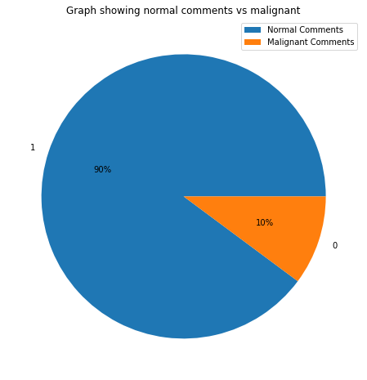
EDA part
Create PIE chart for comments.

Slide 7
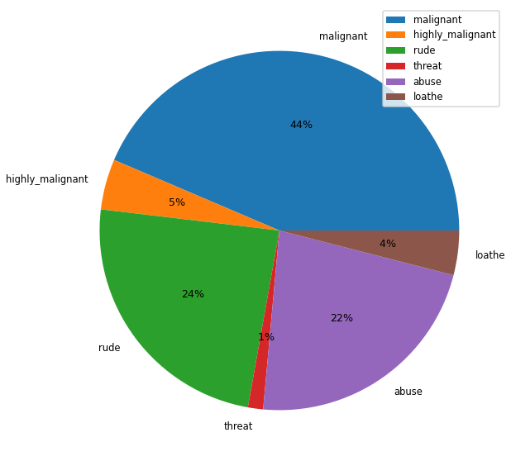
Create pie chart for all the columns.

Slide 8
EDA Part
We Standardice the X’s feature for better result.
We split the data in train and test dataset for fir more models.
Replace some special character in words.
Remove stop words from the text.
Make the text clean.

Slide 9
Details
Use TFIDFvectorizer for make the comments in better form to get the good accuracy rate.
We see that the target feature are in categorical form that’s way we apply Logistic regression and classifire.
Here we apply four models.
Logistic regression
KNN classifire

Slide 10
Result.
We fit all the models with x_train and y_train data.
We found that logistic regression gave the best result.
We save our model with logistic regression
And got the 95% accuracy.

